Slide 1



Welcome to our class
Class 4B

Slide 2
Welcome to our class
Class 4C

Slide 3

50:50

Slide 4

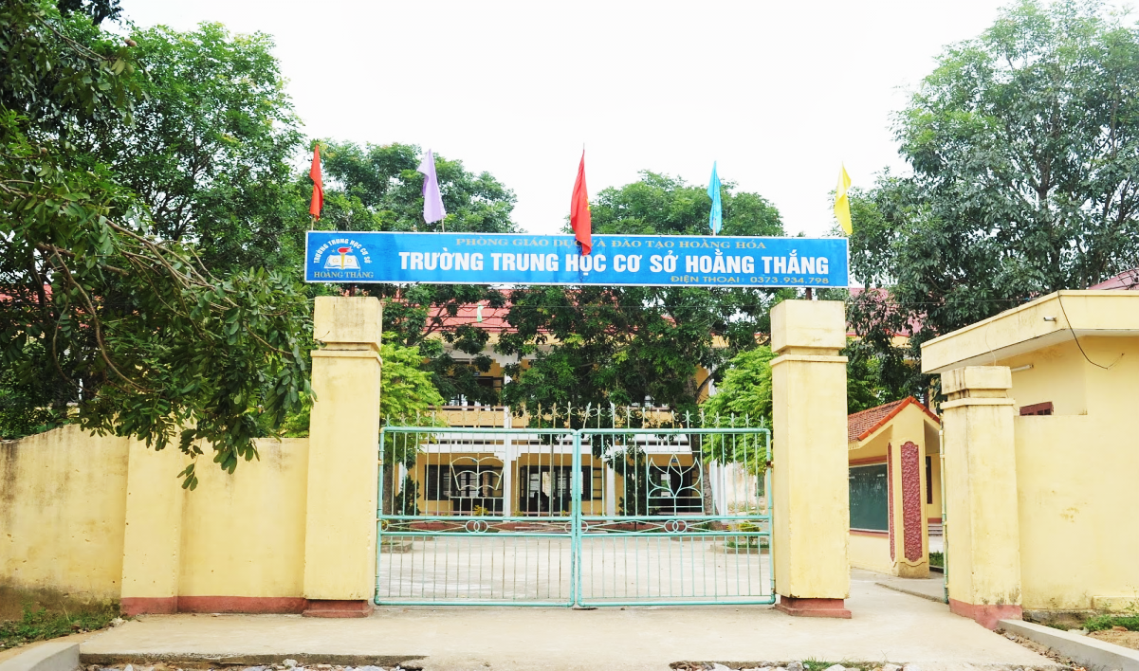


1. What’s the name of your school?
Nang An Primary School
Duc Nhuan
Village
50:50
B. It’s Duc Hiep Primary School.
A. It’s in Duc Nhuan Village.
B. It’s Nang An Primary School.
C. It’s a Duc Nhuan School.
D. It’s at Duc Nhuan School.

Slide 5
2. Where’s your school?
Nang An Primary School
Duc Nhuan
Village
50:50
A. It’s in Duc Hiep Village.
B. It’s Nang An Primary School.
A. It’s in Duc Nhuan Village.
C. It’s a Nang An School.
D. It’s at Duc Nhuan School.

Slide 6
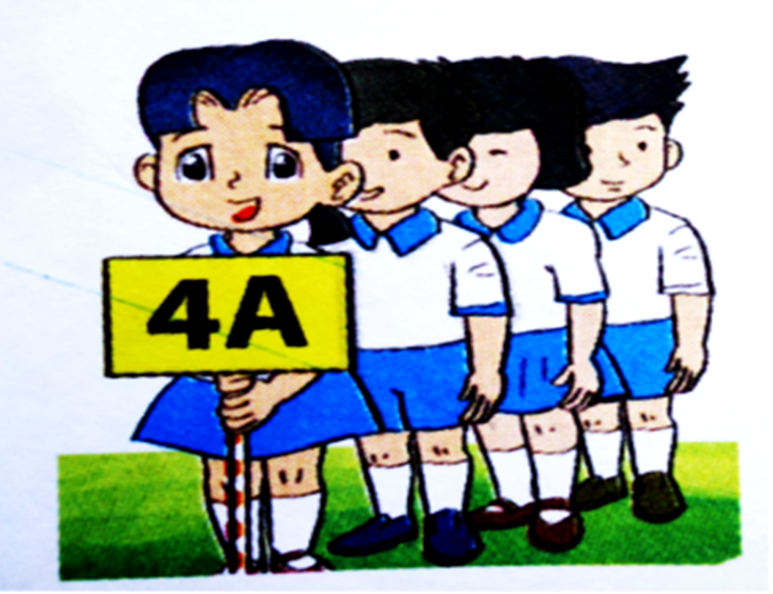
3. What class are you in?
50:50
A. He’s in Class 4A.
B. She’s in Class 4A.
C. I’m in Class 4A.
D. They’re in Class 4A.
C. I’m in Class 4A.

Slide 7
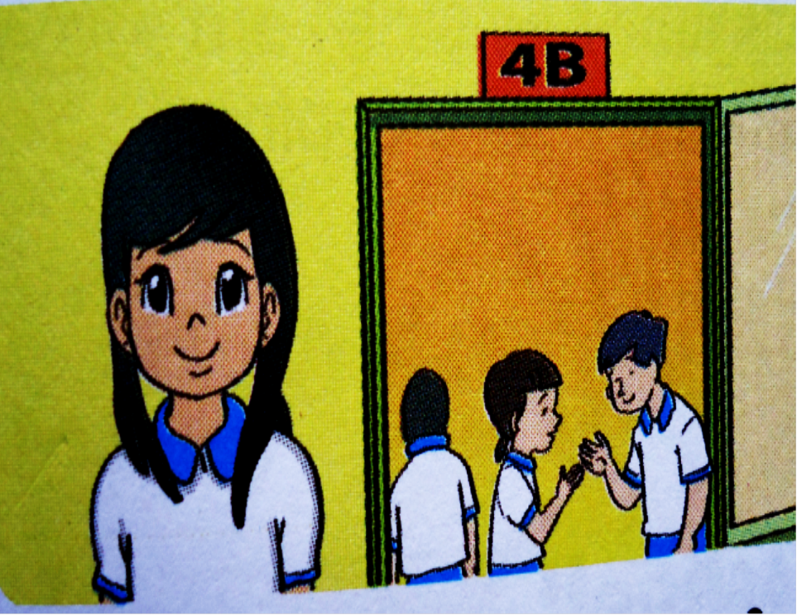
4. What class is she in?
50:50
A. He’s in Class 4B.
B. They’re in Class 4B.
D. She’ in Class 4B.
C. I’m in Class 4B.
D. She’s in Class 4B.

Slide 8
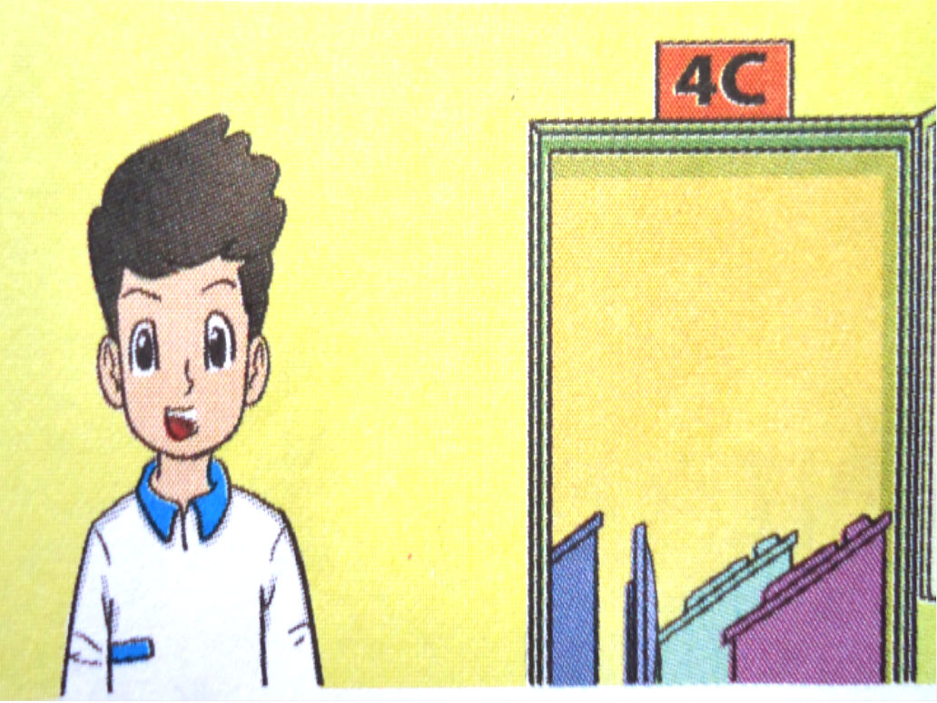
5. What class is he in?
50:50
A. He’ in Class 4C.
B. They’re in Class 4C.
A. He’s in Class 4C.
C. I’m in Class 4C.
D. She’s in Class 4C.

Slide 9
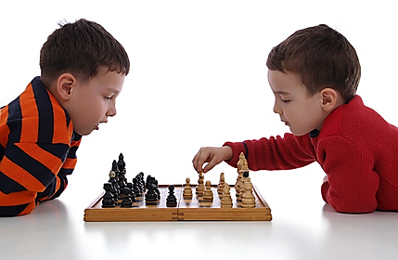
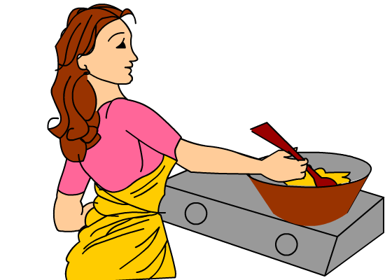
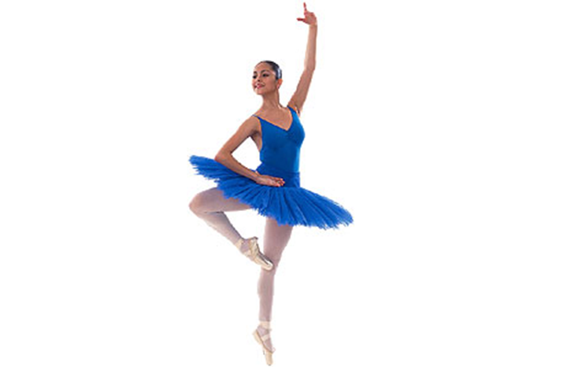
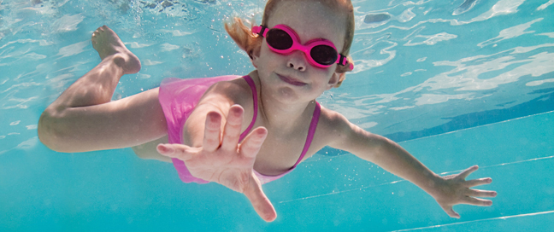

Slide 10


Wednesday, November 24th, 2021.
Unit 7
What do you like doing?
L
e
s
s
o
n
1

Slide 11
I. Vocabulary
V(động từ) | V-ING
swim
swimming
cook
cooking
read
reading
listen
listening
watch
watching
play
playing
fly
flying
collect
collecting
make
making

Slide 12
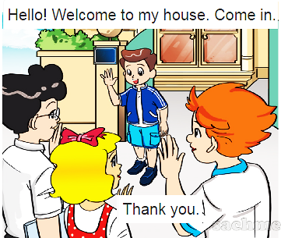
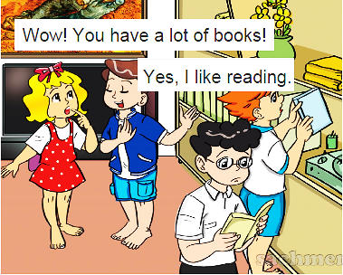
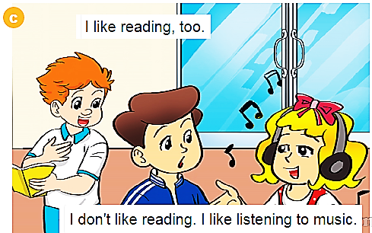
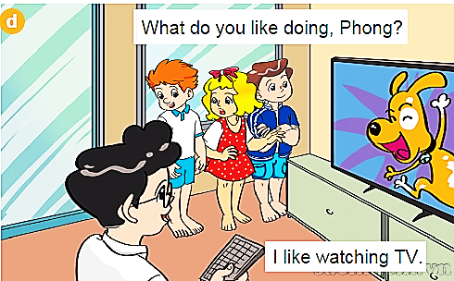

Slide 13
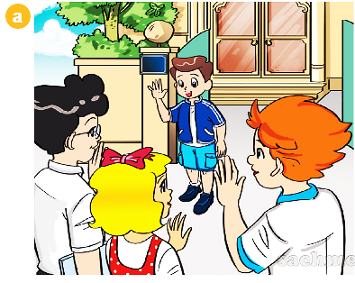
Hello! Welcome to my house. Come in.
Thank you.

Slide 14
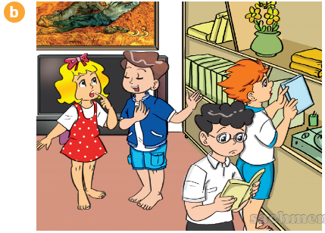
Wow! You have a lot of books.
Yes, I like reading.

Slide 15
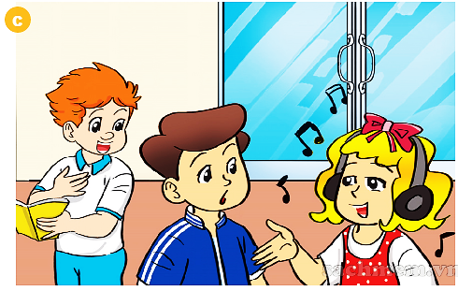
I like reading, too.
I don’t like reading.
I like listening to music.

Slide 16
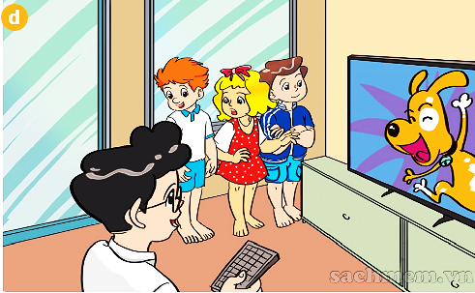
What do you like doing, Phong?
I like watching TV.

Slide 17
Hello! Welcome to my house. Come in.
Thank you.

Slide 18
Wow! You have a lot of books.
Yes, I like reading.

Slide 19
I like reading, too.
I don’t like reading.
I like listening to music.

Slide 20
What do you like doing, Phong?
I like watching TV.

Slide 21
Hello! Welcome to my house. Come in.
Thank you.

Slide 22
Wow! You have a lot of books.
Yes, I like reading.

Slide 23
I like reading, too.
I don’t like reading.
I like listening to music.

Slide 24
What do you like doing, Phong?
I like watching TV.

Slide 26


II. Sentence pattern
What do you like doing?
I like swimming.
I like .
a
swimming

Slide 27

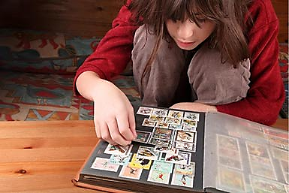
b
What do you like doing?
I like
c
d

Slide 28
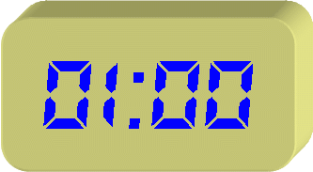
b
What do you like doing?
I like
c
d

Slide 29

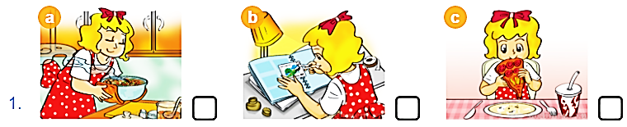
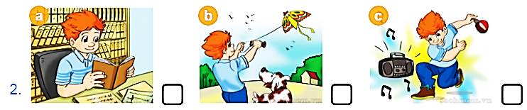
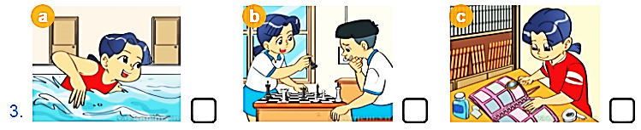
✓
✓
✓

Slide 30
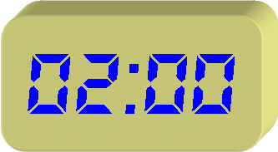

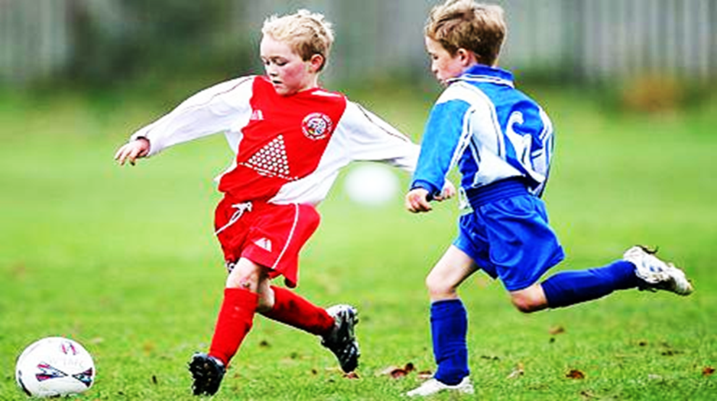
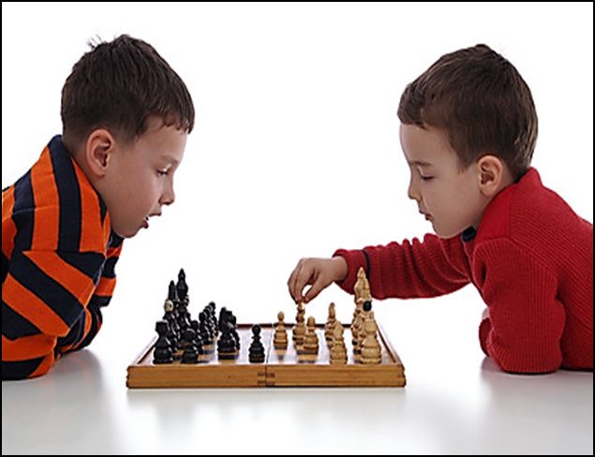
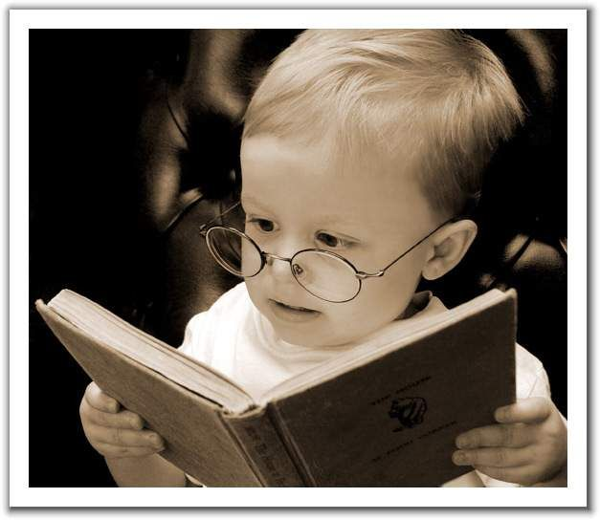
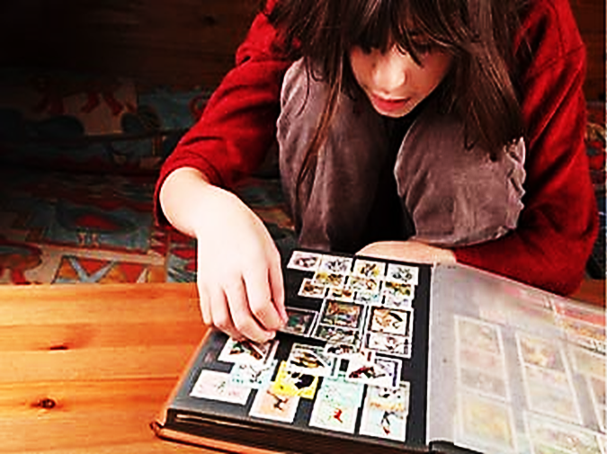
playing football.
playing chess.
1. I like
2. I like
reading books.
3. I like
collecting stamps.
4. I like

Slide 31


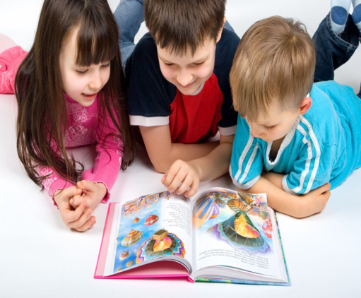
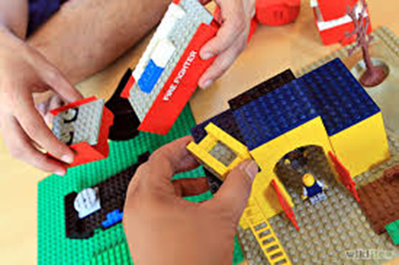

I like reading comic books so much.
Reading comic books is lots of fun.
I like making models, too.
Making models is very cool.
I like collecting stamps so much.
Collecting stamps is lots of fun.
I like playing football, too.
Playing football is very cool.

Slide 32



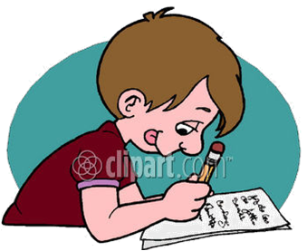
Learn by heart vocabulary and sentence pattern
Prepare Lesson 2

Slide 33




